Slide 1
FINAL PROJECT
Data Analytics and Machine Learning
Spring 2023
By Prof. Mahmoud Daneshmand

Slide 2
PREDICTIVE MODEL FOR CUSTOMER BOOKING
Vanshika Nair
Sakshi Tonde
Shreya Melam
Medha Baddam

Slide 3
Table of Contents
Introduction
CRISP-DM
Business Understanding Phase
Data Understanding Phase
Data Preparation Phase
Data Modeling Phase
Data Evaluation Phase
Data Deployment Phase
Conclusion
References

Slide 4
Introduction
Customers are more powerful than ever before because they have instant access to a multitude of information. This is one of the reasons why the buying cycle is no longer what it once was.
With the use of data and prediction models, this is achievable. The quality of the data used to train the machine learning algorithms is the most significant aspect in a prediction model.
The objective is to use machine learning algorithms and data analytics techniques to create a dependable prediction model that will assist the airline in optimizing its operations and making informed decisions about flight capacity, pricing, and scheduling. The success of this initiative will have far-reaching consequences for
the airline sector, resulting in better customer happiness, more revenue, and lower operating costs.

Slide 5
Business Understanding Phase
The airline industry is very competitive, and airlines are constantly looking for new methods to attract consumers and raise revenue. One method is to forecast client booking behavior and give them customized bargains and incentives that are likely to motivate them to buy a flight ticket.
Predicting client booking behavior, on the other hand, is a difficult process since it requires assessing a large quantity of data from many sources, such as customer demographics, past booking habits, and external factors such as economic trends and seasonal fluctuations.
This project aims to develop a predictive model that can accurately forecast customer booking patterns for an airline. This project's predictive model can assist the airline sector in optimizing operations, increasing revenue, and increasing customer pleasure. The airline can plan its operations, including pricing strategies, promotions, and seat inventories, by properly forecasting passenger booking trends. Furthermore, the model can assist the airline in providing individualized services to its consumers by gaining a knowledge of their preferences and behavior.

Slide 6
Data Understanding
Data source: https://www.kaggle.com/datasets/ghassenkhaled/airways-customer data?datasetId=2914207&select=customer_airways_data.csv
Details: In the discovered data, we have various attributes such as num_passengers, sales_channel, trip_type, booking_origin, flight_hour, flight_duration and so on which helped us better understand how airlines manage their ticketing system. Such detailed data was essential for the algorithm in order to predict the booking patterns in frequent flyers which helped exploring and understanding the available data more efficiently.

Slide 7
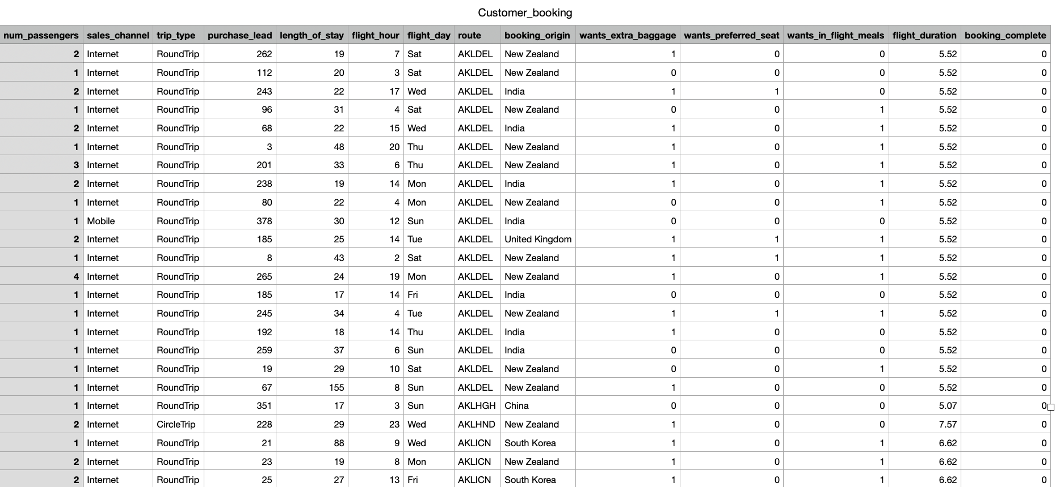
Data Understanding : Sample Data

Slide 8
Data Understanding :Attribute details
num_passengers = number of passengers travelling
sales_channel = sales channel booking was made on
trip_type = trip Type (Round Trip, One Way, Circle Trip)
purchase_lead = number of days between travel date and booking date
length_of_stay = number of days spent at destination
flight_hour = hour of flight departure
flight_day = day of week of flight departure
route = origin -> destination flight route
booking_origin = country from where booking was made

Slide 9
Data Understanding : Attribute details Cont.
wants_extra_baggage = if the customer wanted extra baggage in the booking
wants_preferred_seat = if the customer wanted a preferred seat in the booking
wants_in_flight_meals = if the customer wanted in-flight meals in the booking
flight_duration = total duration of flight (in hours)
booking_complete = flag indicating if the customer completed the booking

Slide 10
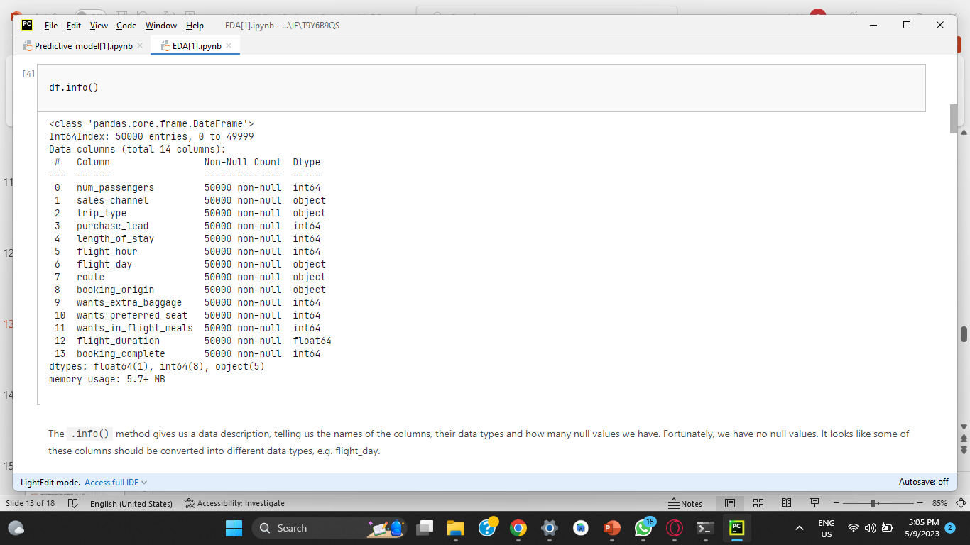
Attribute Information

Slide 11
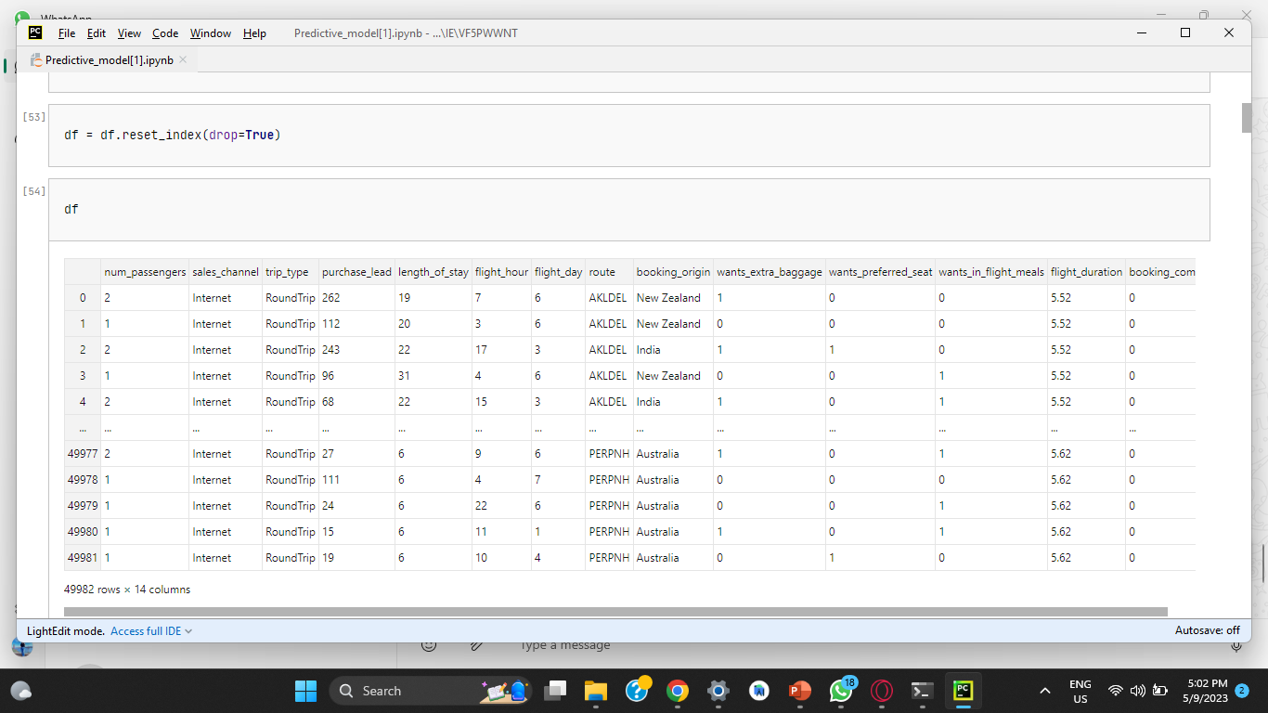
Dataset

Slide 12
Data Preparation
Once the data is properly explored, it is cleaned and prepared for the next phase.
The dataset is prepared to be tested, starting with converting any data types of any columns to be able to work with the algorithm well.
Necessary libraries are imported, here we used numpy and pandas.
Any missing data i.e null values are handled.
Since our dataset contains categorical variables, we need to convert them into numerical form that can be processed by the Random Forest classifier. We can use techniques like one-hot encoding or label encoding to achieve this.
We used One-hot encoding as it creates binary variables for each category.
Since our end goal is to predict potential ticket sales, we need to filter out the data to better understand the sales and train it.
Data was filtered to have only purchase lead sales less than 600 days.

Slide 13
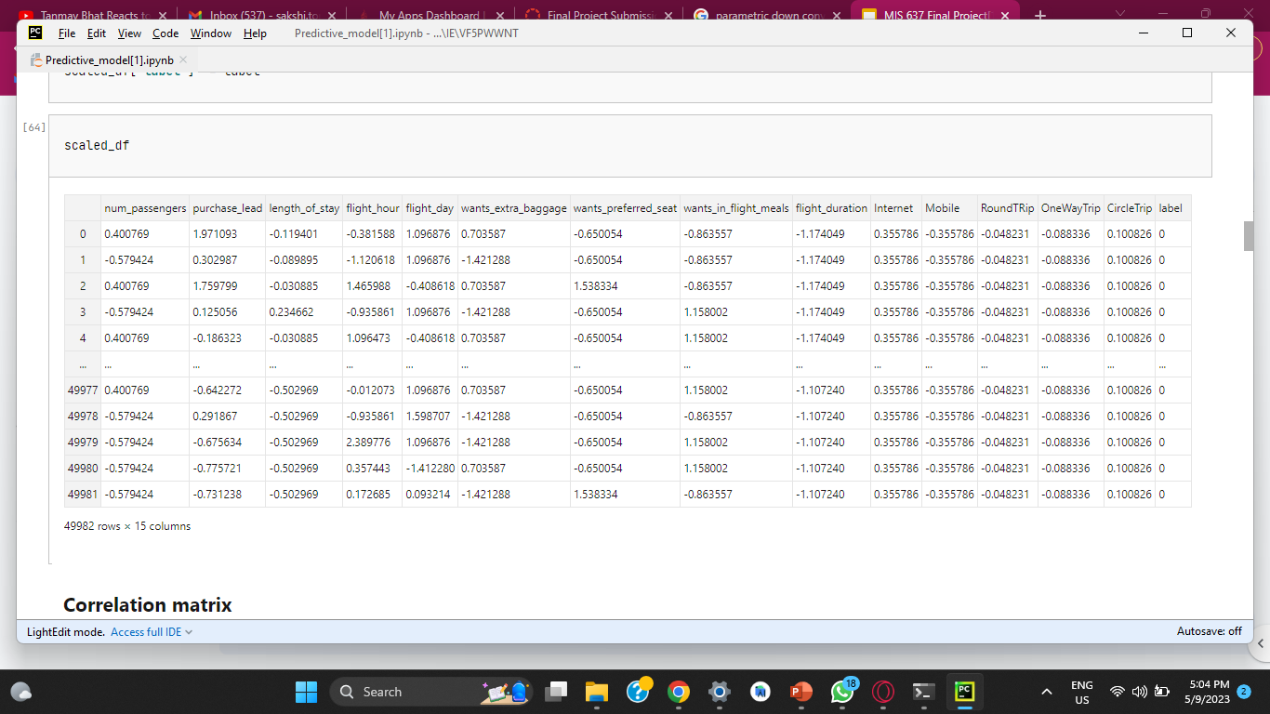
Scaled Dataset

Slide 14
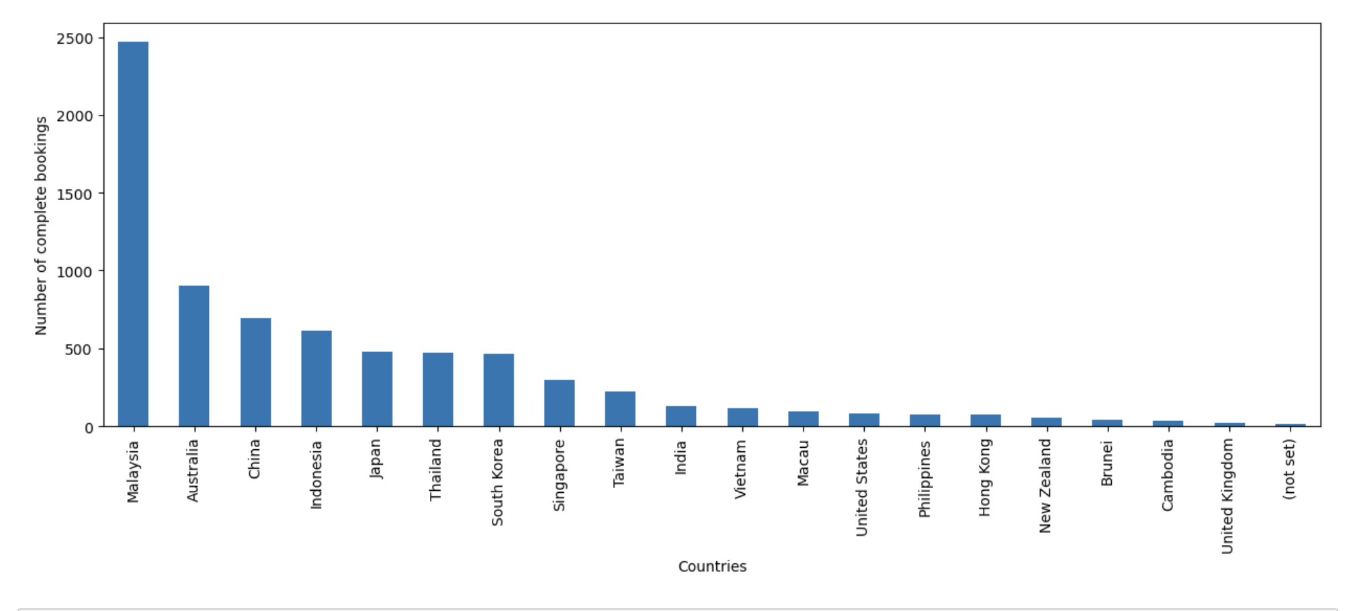
Booking data

Slide 15
Algorithm: Random forest classifier
Based on the business objectives and data understanding, choosing the appropriate modal is crucial.
The algorithm used in the project is Random Forest Algorithm. Random Forest is a well-known machine learning technique that may be used to anticipate consumer bookings for an airline.
It is an ensemble learning approach that integrates many decision trees to increase the model's accuracy and resilience.
Random Forest works by picking a subset of the training data and a subset of the features at random for each decision tree, ensuring that each tree is unique and has its own interpretation of the data. The output of each tree is pooled to form the final forecast during the prediction phase.
Random Forest can be used in the context of customer booking for an airline to detect patterns and estimate the possibility of a consumer booking a flight by analyzing multiple criteria such as flight dates, ticket pricing, customer demographics, flight routes, and previous booking data.
The model's findings can be utilized to optimize pricing and marketing initiatives, improve customer experience, and increase revenue for the airline.

Slide 16
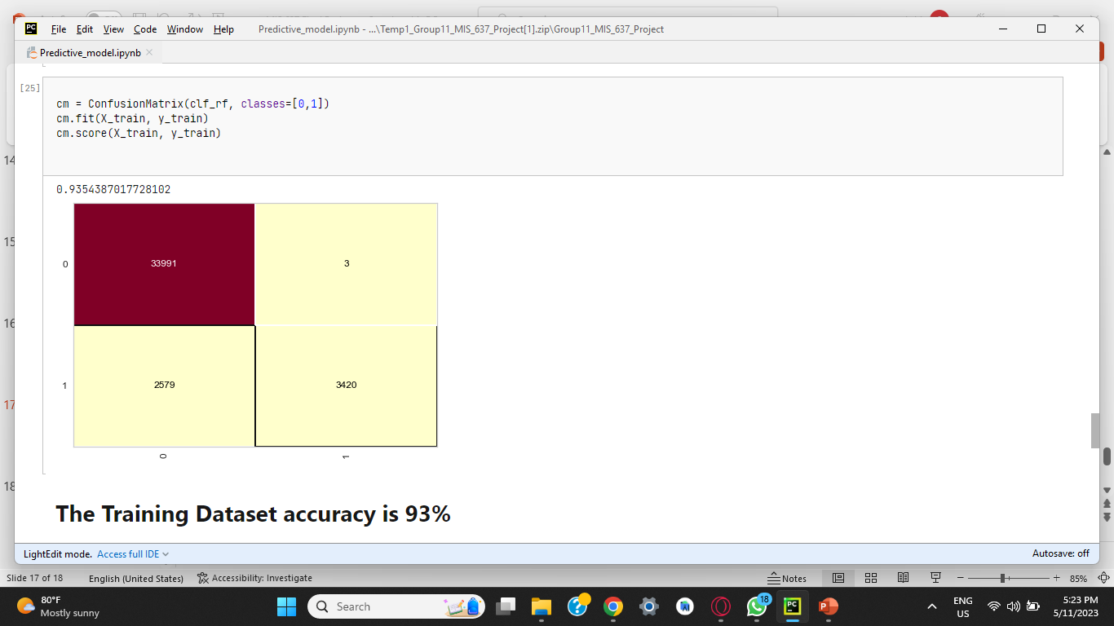
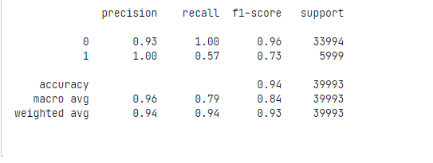
Results

Slide 17
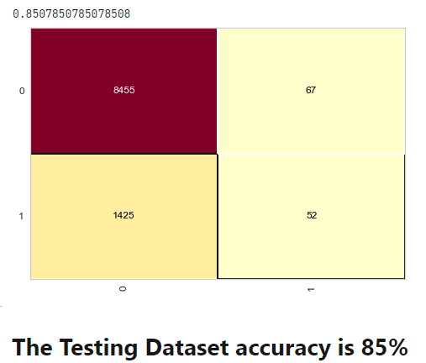
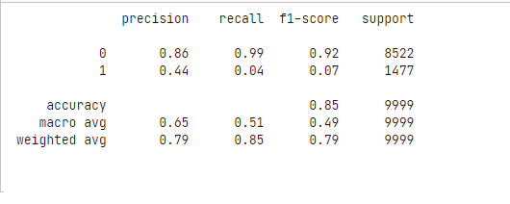
Results

Slide 18
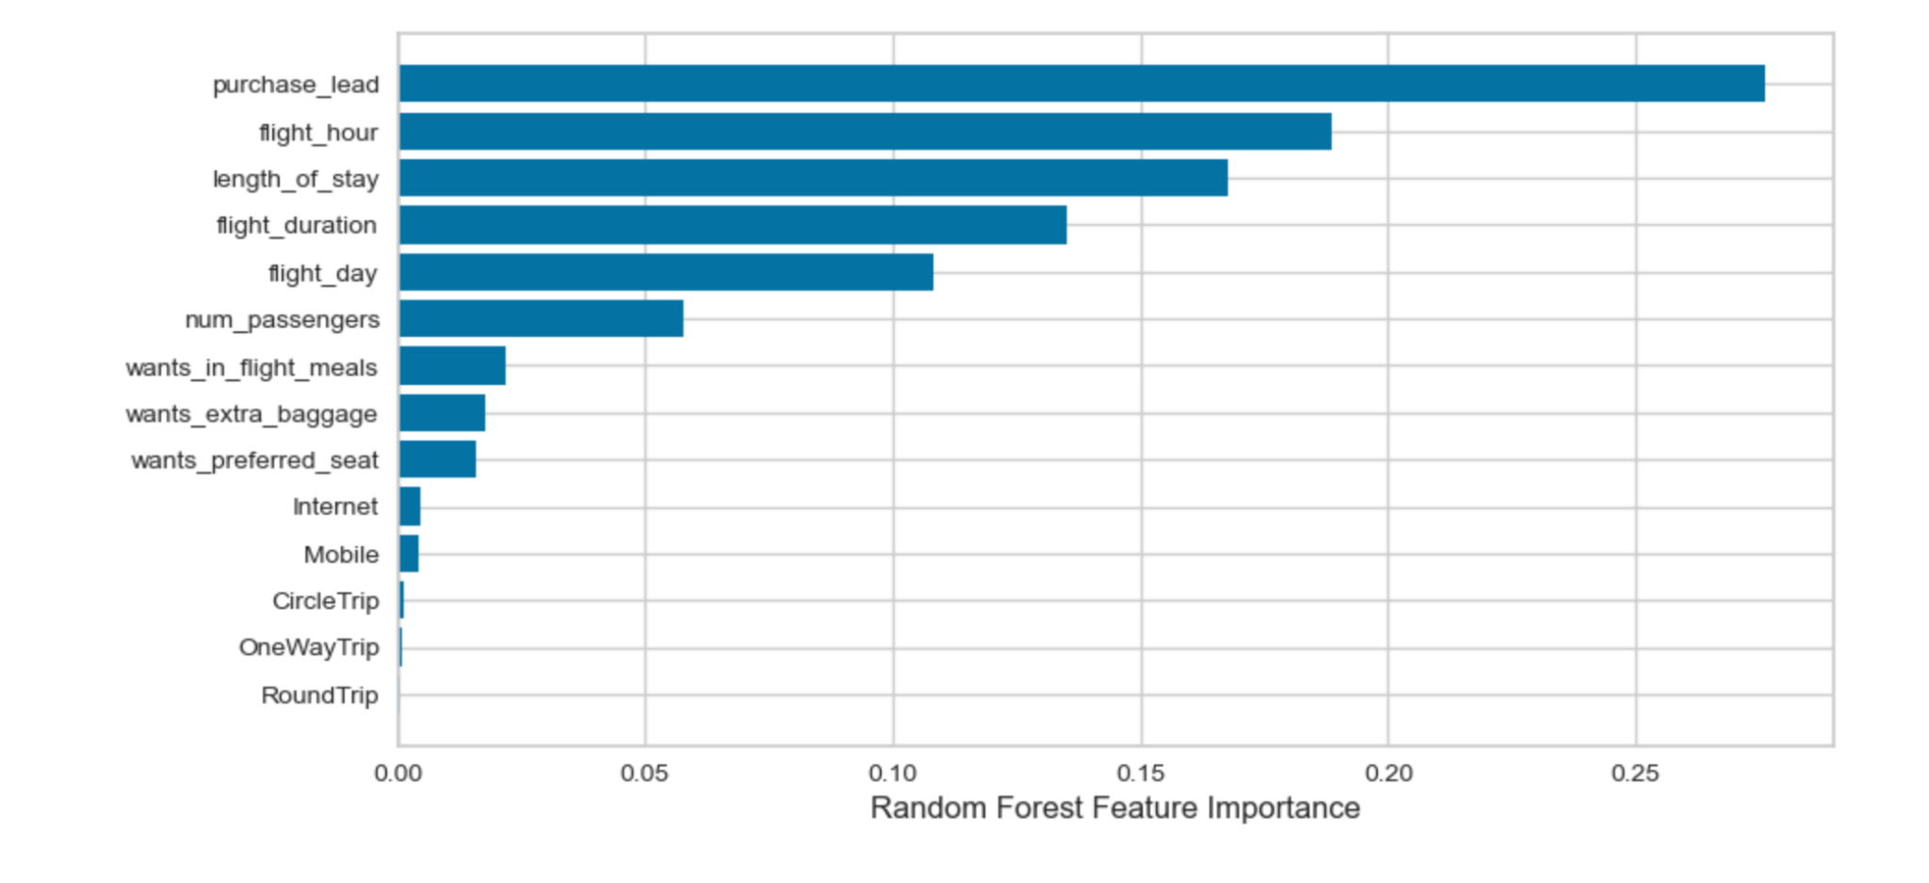
Results

Slide 19
Results
Using RandomForest Classifier, the features important are:
purchase_lead
flight_hour
lenghth_of_stay
flight_duration
flight_day
num_passengers
The country that had maximum booking applications is Australia.
The country that had their maximum booking completed is Malaysia.

Slide 20
THANK YOU

